Slide 1

Why Childcare Costs Matter
An Interactive Discussion on Affordability & Equity
Hosted by: Hae Ji Chong

Slide 2
Childcare Costs by Age
• Infant care averages up to $430/week
• Preschool is lower, but still burdensome
• Cost varies widely across states

Slide 3
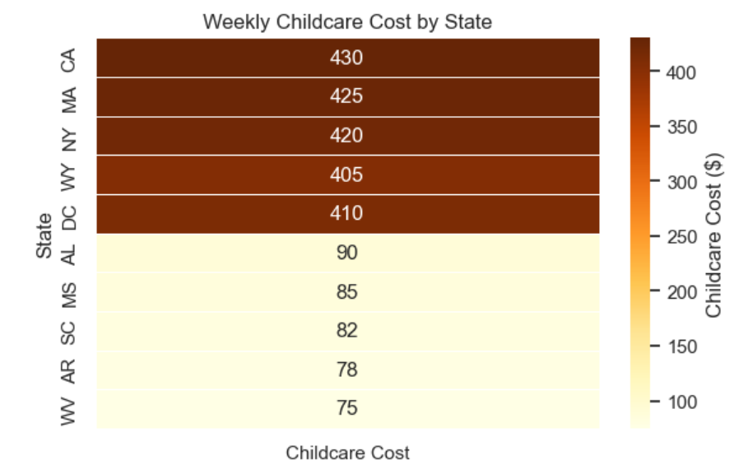
`
Cost Extremes Across the U.S.
Top 5 vs Bottom 5 Counties for Infant Childcare

Slide 4
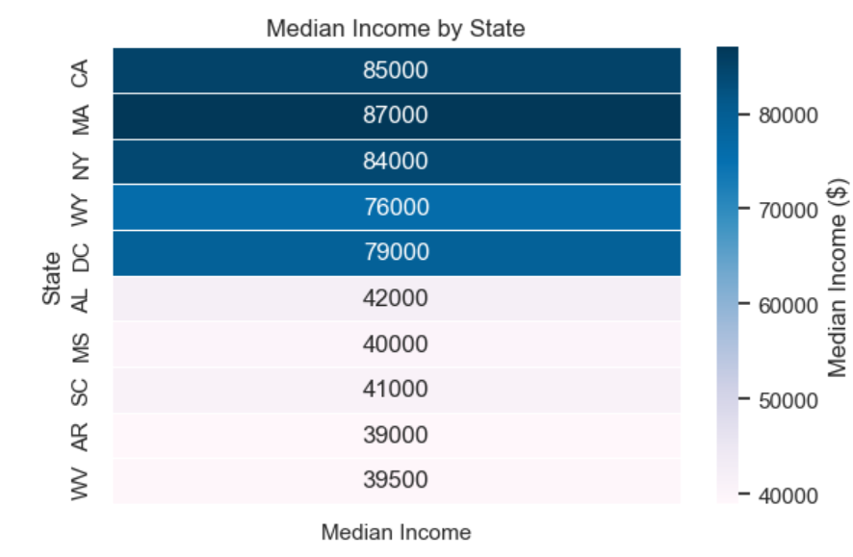

Slide 5
`
Real Voices
"That’s more than my rent" – Emma, Boston
"We drive 40 minutes to save money" – Malik, Tennessee

Slide 6
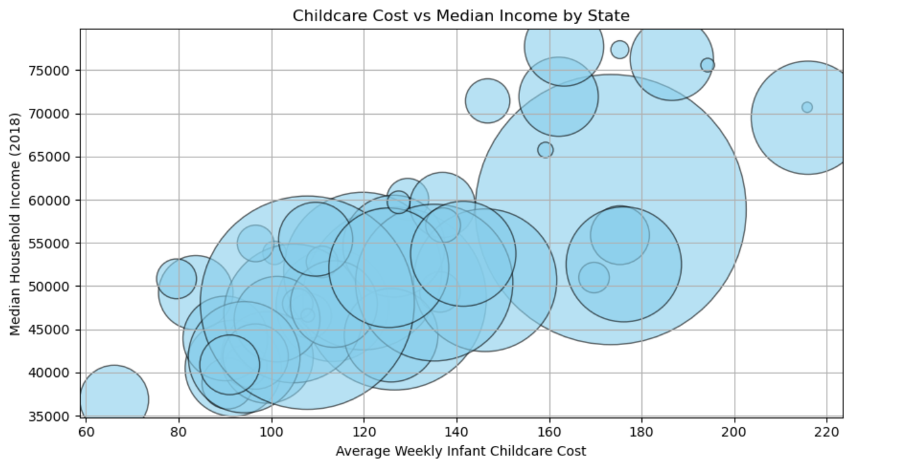
Do Higher Wages Mean Higher Costs?
A look at the disconnect between income and childcare prices

Slide 7
Let's Hear From You!
• How much do you pay for childcare?
• What sacrifices do you make to afford it?
→ Use the poll link or chat to share your experience

Slide 8
Q&A
Ask your questions in the chat or unmute to share.

Slide 9
Take Action
• Visit ChildCareAware.org or local advocacy groups
• Share your story with your representative
• Let’s work toward affordable childcare for all

